Slide 1

Yankee Chapter
2020 Treasurer’s Report

Slide 2
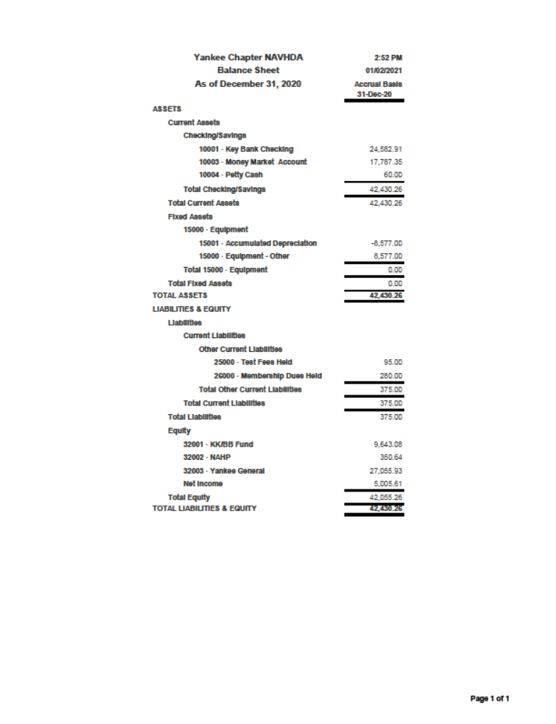
Key Bank Checking $24,582.91
Money Market $17,787.35
Petty Cash $60.00
KK / BB $9643.08
NAHP $350.00
Yankee General $27055.93
Net Income $5005.61
Total $42,430.26

Slide 3
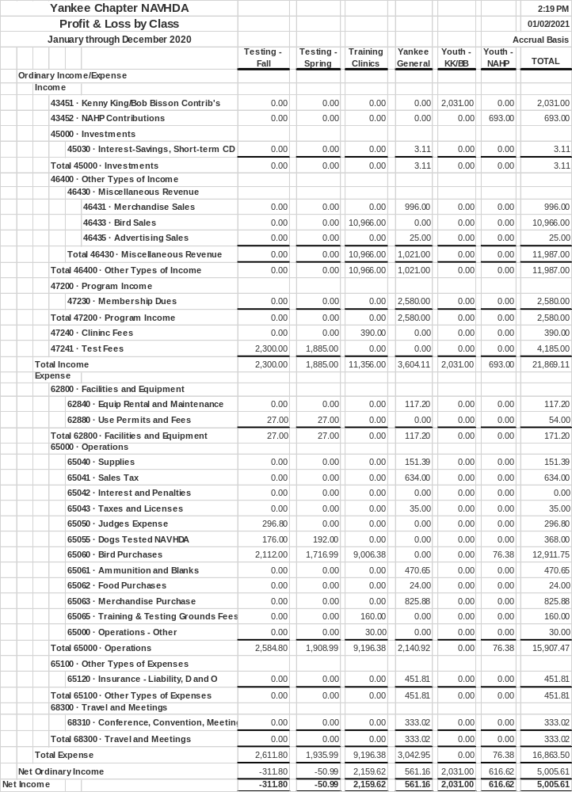







Income Sources
Income Total $21,869.11
Fall Test
SP Test
Clinics
General
KK / BB
NAHP
Totals
 |  | Total Expense |  |  |  | 2,611.80 |  | 1,935.99 |  | 9,196.38 |  | 3,042.95 |  | 0.00 |  | 76.38 |  | 16,863.50
 | Net Ordinary Income |  |  |  |  | -311.80 |  | -50.99 |  | 2,159.62 |  | 561.16 |  | 2,031.00 |  | 616.62 |  | 5,005.61
Net Income |  |  |  |  |  | -311.80 |  | -50.99 |  | 2,159.62 |  | 561.16 |  | 2,031.00 |  | 616.62 |  | 5,005.61
Expenses
Expenses Total $16,863.50

Slide 4
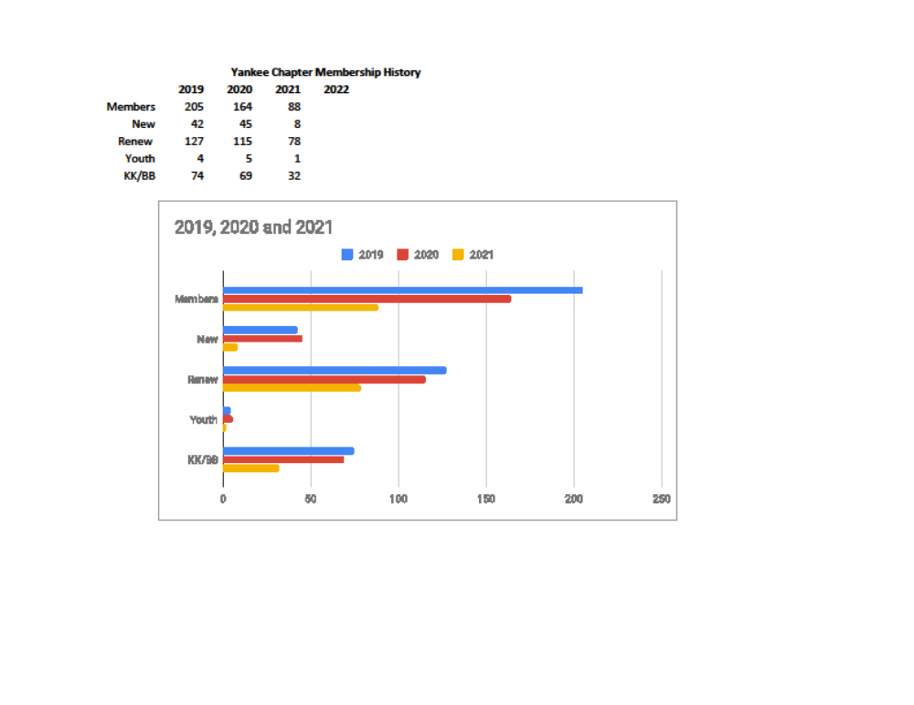

Slide 5
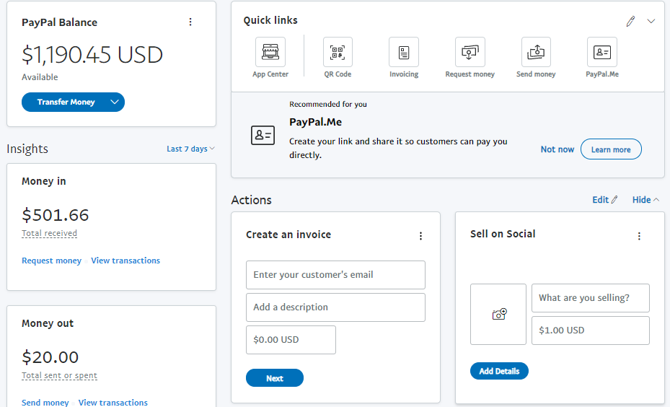
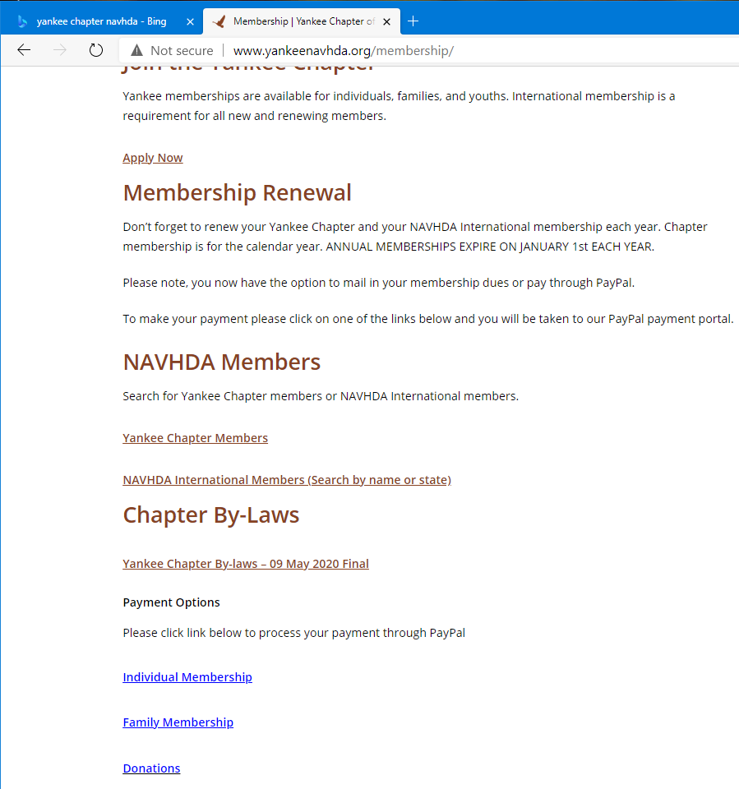
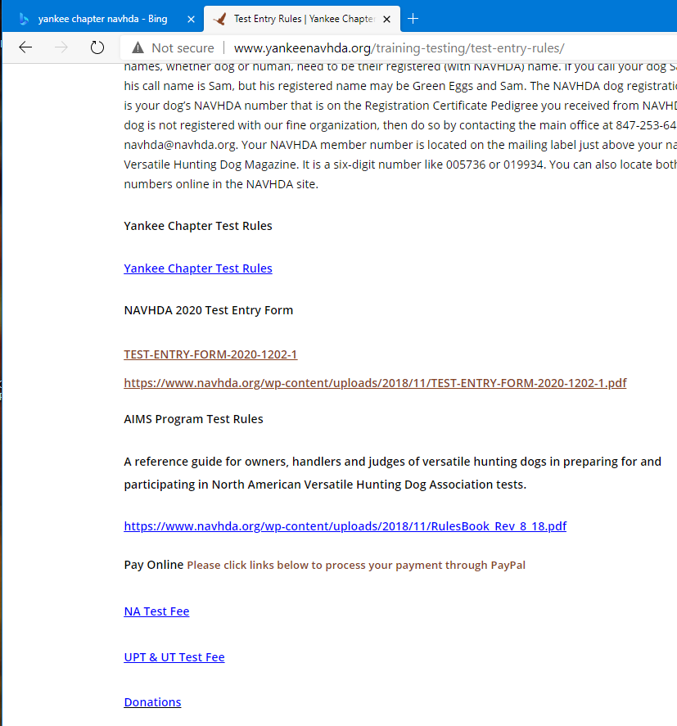
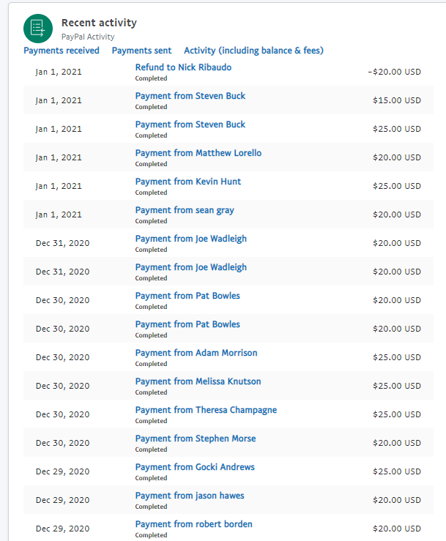
Yankee Chapter Website Links to PayPal
PayPal Home Page
PayPal Recent Activity

Slide 6

Thank You

